Slide 1




CAPSTONE PROJECT WITH PYTHON
Student’s early attrition model for Clearwater state university
Sagar Ganesh Vaishnav

Slide 2
PROJECT DESCRIPTION
Key strategic goals
Clearwater State University offers a wide variety of degree programs – Classroom sessions, online degrees to doctorate in education.
Various Programs are offered in the streams of the arts, education, business & nursing
Improve retention, progression and graduation rates
Increase external funding and recognition
Recruit better academically qualified students

Slide 3
Slide 3
PROBLEM STATEMENT
Student’s Early Attrition
2) Build a predictive model to identify students with higher attrition risk
3) Recommend appropriate interventions based on Analysis
1) Identify key drivers of Early Student Attrition
Clearwater State University has collected student data to check the enrollment to the curriculum programs and the percentage students continuing to the next year
It was observed that many students are opting out from continuing the next year.
The rate of attrition was around 23 - 25%.
An exercise was done to collect data from all enrolled students and the reasons why they did not continue their studies
Data analysis and visualization techniques are used to arrive the root cause of attrition and develop a strategic retention plan

Slide 4
Exploratory Data Analysis& Data Preparation
Reading and checking size of data
Descriptive Statistics : Basic measures of central tendency were used to validate if correct data is being used for modelling
Missing Value treatment : Imputing Missing Values with mean for numeric and mode for categorical values
Correlation : Checking the correlation between the variables for further predictive analysis
Notes:
When conducting research, it is easy to go to one source: Wikipedia. However, you need to include a variety of sources in your research. Consider the following sources:
Who can I interview to get more information on the topic?
Is the topic current and will it be relevant to my audience?
What articles, blogs, and magazines may have something related to my topic?
Is there a YouTube video on the topic? If so, what is it about?
What images can I find related to the topic?

Slide 5
Exploratory Data Analysis & Data Preparation
Response Variable Coding
- Converting ‘RETURNED_2ND_YR’ variable to 0 and 1 accordingly as python will model
for event 1
Outlier Detection
- To ensure we don’t have highly skewed values
- Student Age and Distance from home are highly skewed
- Normalizing the data to mitigate the effect of Outliers
Notes:
Once you find your sources, you will want to evaluate your sources using the following questions:
Author:
Who is the author?
Why should I believe what he or she has to say on the topic?
Is the author seen as an expert on the topic? How do you know?
Current:
How current is the information in the source?
When was the source published?
Is the information out-of-date?
Accuracy:
Is the content accurate?
Is the information presented objectively? Do they share the pros and cons?

Slide 6
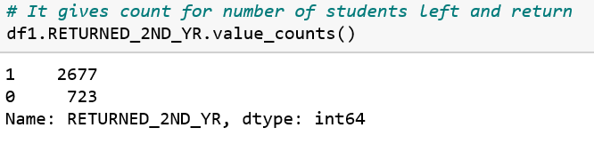

Percentage of attrition
Here we can see that Out of 3400 students, 723 left the college and 2677 were returned back to 2nd year
Total 21.26% students left the college
Notes:
After consulting a variety of sources, you will need to narrow your topic. For example, the topic of internet safety is huge, but you could narrow that topic to include internet safety in regards to social media apps that teenagers are using heavily. A topic like that is more specific and will be relevant to your peers. Some questions to think about to help you narrow your topic:
What topics of the research interest me the most?
What topics of the research will interest my audience the most?
What topics will the audience find more engaging? Shocking? Inspiring?

Slide 7
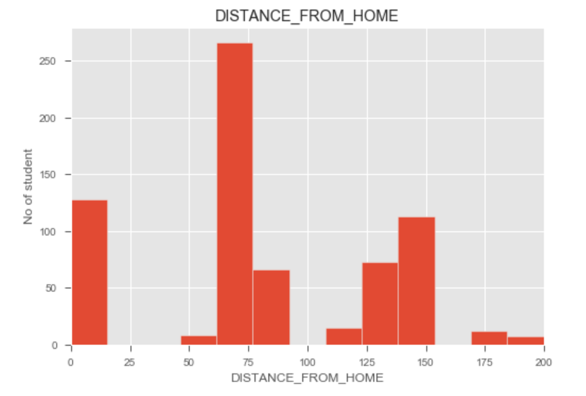
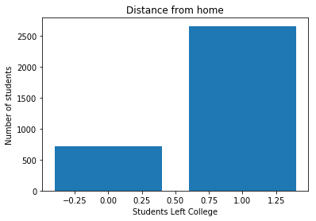

Data Visualization by plotting Histogram : Distance from Home
We can infer from the graph that Students who left the college are 60 to 80 km away from college
Overall 48% students have left because of far distance from home
Distance from home distribution is positively skewed
Notes:
Now, that you have narrowed your topic, you will want to organize your research in a structure that works. There are some common organizational patterns based on the kind of research you are doing.
Organizational Structures:
Cause and Effect- this kind of structure is great for explaining the causes and effects of a topic
Compare and Contrast- in this pattern you highlight the similarities and differences of the topic
Explain process- this structure is great for outlining a series of steps to follow;
Definition- if you want to make sure your audience understands what something is using illustrations, meanings, clarifying misconceptions, you may want to use this structure
Classification- a common organizational structure is grouping like topics or facts from the research together. For instance, in the internet safety about social media apps, you may organize the research where you look at each social media app one at a time

Slide 8
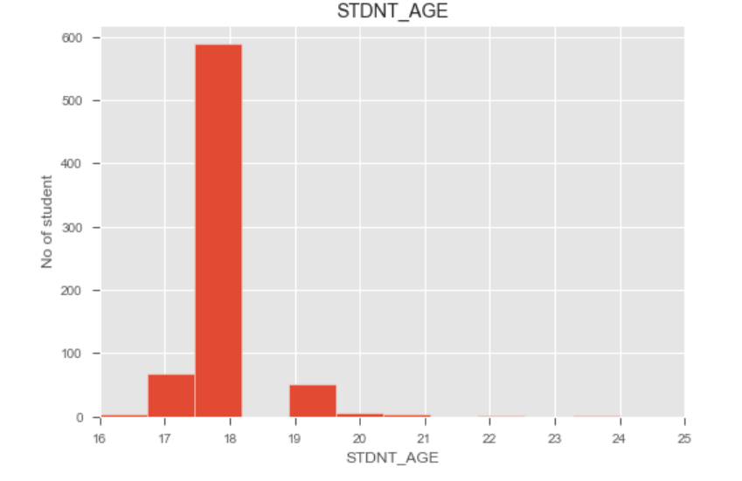

Data Visualization by plotting Histogram : Student Age
Age distribution is a slightly right-skewed distribution
Bulk of the students who left are 18 years old
Notes:
After you’ve done your research, it’s time to put your presentation together. The first step in the process is to introduce the topic. This is a great time to connect your topic to something that your audience can relate. In other words, why should they listen to all the information you will be sharing in your research presentation? What is in it for them? You may also want to include a graphic or image to grab their attention.
Feel free to duplicate this slide by right-clicking on this slide in the slides pane to the left and select Duplicate Slide.
The next step in your presentation is to state your claim or topic clearly. Your teacher may even call this your thesis. As you state your thesis, you may find that this layout is not the best layout for your claim or topic. You can change the layout by clicking the drop-down menu next to the Layout in the Slides menu section. You can choose Two Content, Comparison, or Picture with Caption. Note: A different layout might change the look of the icons on this page.
You will also want to state your facts. You have done the research now share some of the interesting facts with your audience. Facts do not have to be boring; you can communicate facts in a variety of ways by going to the Insert Tab. In the Insert tab you can:
Insert pictures from your computer or online.
Add a chart
Create some SmartArt
Insert a variety of icons to help your facts come to life. Note: You can change the color of the icons by selecting the icon and then click on the Format tab and then Graphics Fill. From there, you will choose a color from the list or choose More Fill Colors to give you more options.
Since this research presentation is a result of your hard work and searching, you want to make sure you support the claims or points in your presentation with facts from your research findings. Make sure you give the author proper credit for helping you share your ideas. If one of your sources has a video that is relevant to your topic, you can add the video as added support. Keep in mind the length of the video and the amount of time you have for your presentation. For a 5 minute speech, the video should be no longer than 30 seconds.
Questions to consider:
How will you state the author of the source?
Will you need to cite the source on the slide?
What are some ways you can engage your audience so they feel like they are a part of the presentation? Some ideas to consider is by taking a quick poll like: by a show of hands, how many of you think school uniforms are a way to cut down on bullying? Another suggestion is to have them hold up a certain number of fingers to see if they agree or disagree. Finally, you can share a story that the audience can relate to that makes them laugh.
After all the applause, your audience may have some questions. Be prepared to answer some of their questions by making a list of questions you think they might ask. You may also want to share the presentation with them by providing the link to your presentation, if they want more information.

Slide 9
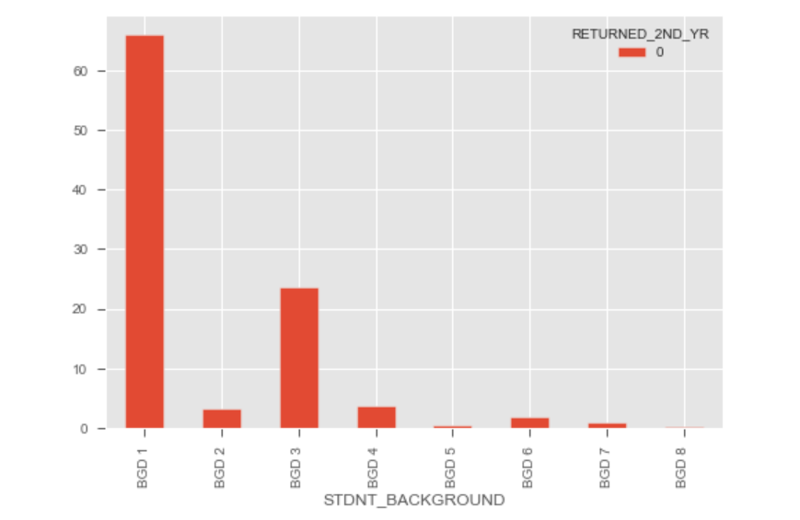
Data Visualization by plotting Histogram : Student Background
Majority of students who left college are from BGD1 followed by BGD3
Notes:
You can use this slide as your opening or closing slide. Should you choose to use it as a closing, make sure you review the main points of your presentation. One creative way to do that is by adding animations to the various graphics on a slide. This slide has 4 different graphics, and, when you view the slideshow, you will see that you can click to reveal the next graphic. Similarly, as you review the main topics in your presentation, you may want each point to show up when you are addressing that topic.
Add animation to images and graphics:
Select your image or graphic.
Click on the Animations tab.
Choose from the options. The animation for this slide is “Split”. The drop-down menu in the Animation section gives even more animations you can use.
If you have multiple graphics or images, you will see a number appear next to it that notes the order of the animations.
Note: You will want to choose the animations carefully. You do not want to make your audience dizzy from your presentation.

Slide 10
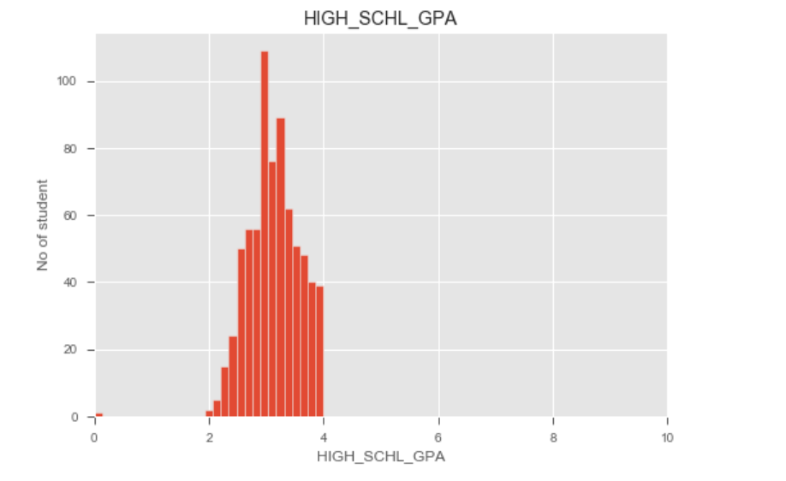

Data Visualization by plotting Histogram : High School GPA
Majority of students
who left college have High School GPA ranging between 2 to 4

Slide 11
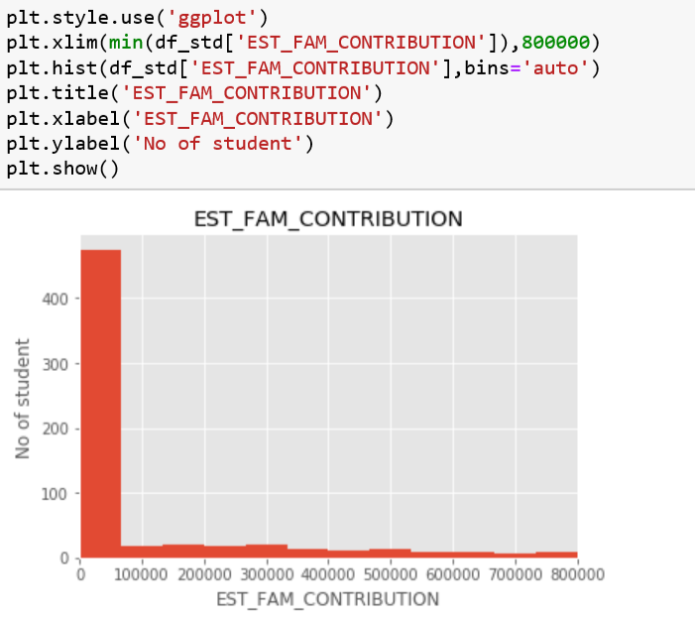
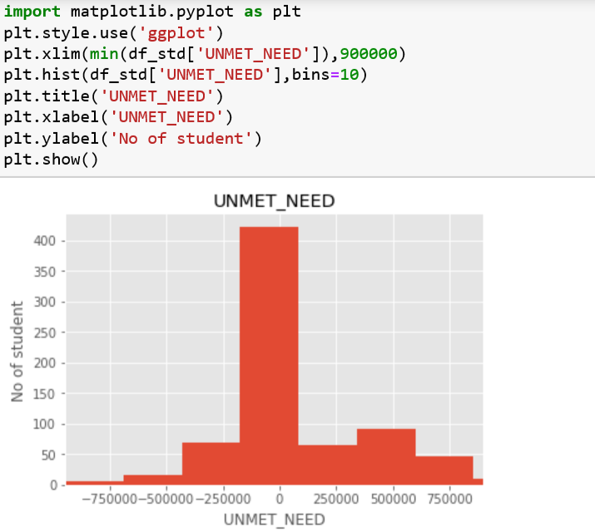

Data Visualization by plotting Histogram : Unmet Needs and Family Contribution
Students whose needs were not met those students left percentage is 48%
Students whose family contribution is less than 1 lakh –Left % is 66%
Unmet needs and Estimated Family Contribution are showing Negative Correlation

Slide 12
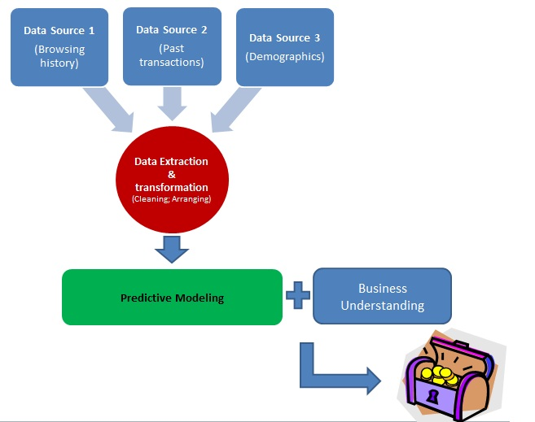

Model Building for Prediction
Here we have Built a predictive model to identify students with higher Early Attrition Risk

Slide 13

SPLITTING DATA INTO TRAINING AND TESTING SETS
The data we use is usually split into training data and test data. The training set contains a known output and the model learns on this data in order to be generalized to other data later on. We have the test dataset (or subset) in order to test our model's prediction on this subset . Train/test is used to measure the accuracy of model

Slide 14
Building Machine Learning Models
The algorithms considered in this section are
Logistic Regression
Random Forest
Decision Tree Classifier
XGboost

Slide 15
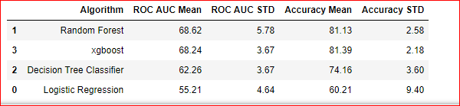
Comparison of models w.r.t ROC/AUC and Accuracy mean
Classification Accuracy is the number of correct predictions made as a ratio of all predictions made. It is the most common evaluation metric for classification problems.
From above table- XG Boost and Random forest are best model for further prediction analysis

Slide 16
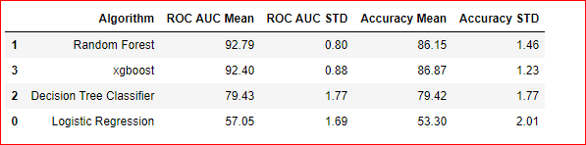
ROC/AUC and Accuracy mean after SMOTE Analysis
SMOTE (synthetic minority oversampling technique) is one of the most commonly used oversampling methods to solve the imbalance problem.
SMOTE synthesizes new minority instances between existing minority instances. It generates the virtual training records by linear interpolation for the minority class

Slide 17
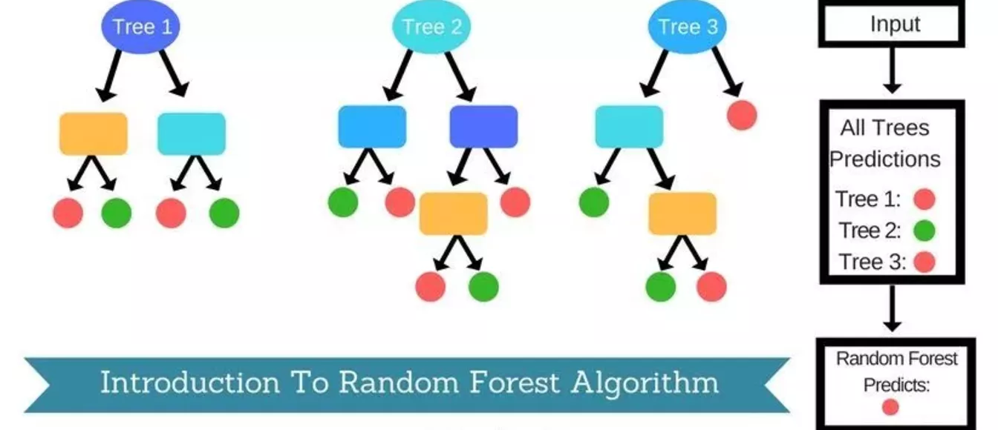
Random Forest
Random Forest is a popular and versatile machine learning method that is capable of solving both regression and classification
Random Forest is a brand of Ensemble learning, as it relies on an ensemble of decision trees. It aggregates Classification (or Regression) Trees
A decision tree is composed of a series of decisions that can be used to classify an observation in a dataset
Random Forest fits a number of decision tree classifiers on various sub-samples of the dataset and use averaging to improve the predictive accuracy and control over-fitting
Random Forest can handle a large number of features, and is helpful for estimating which of your variables are important in the underlying data being modeled

Slide 18
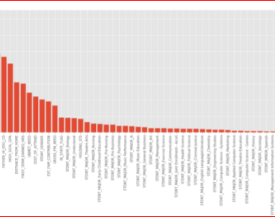
Use of Feature importance – To find out Top contributors
*Top ten contributors
Second Term earned hours
First term earned hours
Distance from home
Family contribution
Cost to attend
Gross financial needs
Mother higher education
Father higher education
Gender
Housing stat

Slide 19
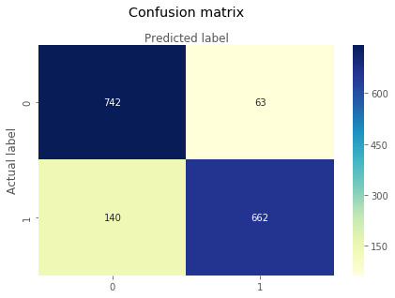
Confusion Matrix
Confusion Matrix : A confusion matrix is a performance measurement for machine learning classification problem where output can be two or more classes. It is a table with 4 different vales of Actual and predicted Values
Classification Rate/Accuracy: Accuracy = (TP + TN) / (TP + TN + FP + FN) = (669+ 737) /(669+ 737 + 68 + 143) = 0.869
Recall: Out of all the positive classes , how much we predicted correctly . It should be high as possible Recall = TP / (TP + FN) = 669 / (669 + 143) =0.82
Precision: Out of all the positive classes we have predicted correctly, how many are actually positive.. Precision = TP / (TP + FP)=669/ (669+68) = 0.90
F-measure: Fmeasure = (2 * Recall * Precision) / (Recall + Precision) = 2 *( 0.82 * 0.90) / (0.82 + 0.90) = 0.86

Slide 20
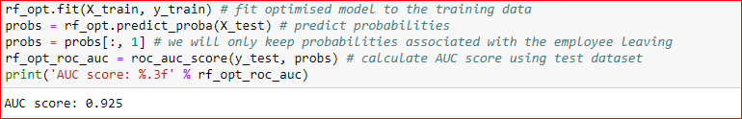
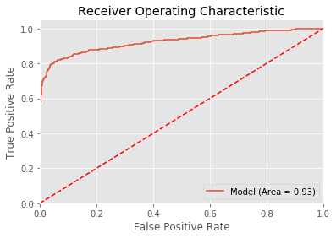
RANDOM FOREST—AUC SCORE
AUC Score : 0.925

Slide 21
XG Boost
XGBoost is an implementation of gradient boosted decision trees designed for speed and performance that is dominative competitive machine learning
The two reasons to use XGBoost are also the two goals of the project: Execution Speed. Model Performance
XGBoost Execution Speed Generally, XGBoost is fast. Really fast when compared to other implementations of gradient boosting
XGBoost Model Performance XGBoost dominates structured or tabular datasets on classification and regression predictive modeling problems

Slide 22

XG Boost- ROC/AUC score
AREA UNDER THE ROC CURVE AUC is an effective way to summarize the overall diagnostic accuracy of the test
It takes values from 0 to 1, where a value of 0 indicates a perfectly inaccurate test and a value of 1 reflects a perfectly accurate test. AUC can be computed using the trapezoidal rule.3
Model score = 0.88

Slide 23
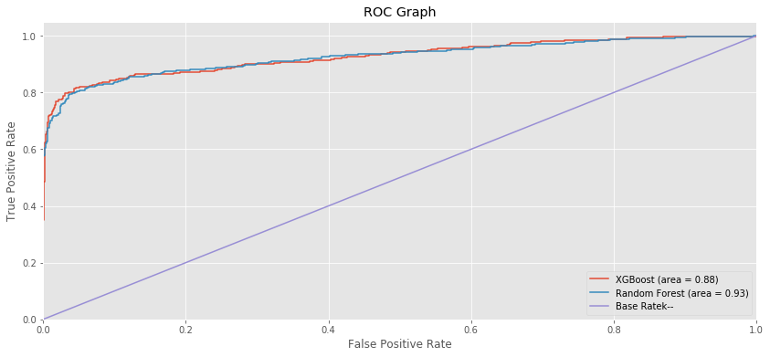
Multi model – comparison of AUC scores

Slide 24
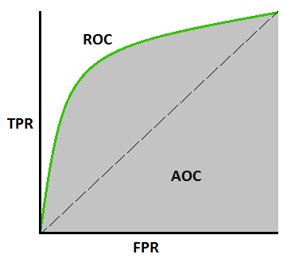
TPR, FPR definitions :
A useful tool when predicting the probability of a binary outcome is the Receiver Operating Characteristic curve, or ROC curve
It is a plot of the false positive rate (x-axis) versus the true positive rate (y-axis) for a number of different candidate threshold values between 0.0 and 1.0. Put another way, it plots the false alarm rate versus the hit rate.

Slide 25
*Conclusion & Recommendation

Slide 26
Conclusion Remarks:
Case Study : Clearwater State University offers a wide variety of degree programs, from online degrees to a doctorate in education. Programs are offered in the streams of the arts, education, business & nursing
Objective of Project : To Leverage data on student demographic profile, course preferences, performance record, grades, financial background, financial aid and other application information to:
1) Identify key drivers of early student attrition
2) Build a predictive model to identify students with higher early attrition risk
3) Recommend appropriate interventions based on the analysis
Remarks
Following are key drivers identified from analysis which are potential cause of student attritions.
Second term earned hours
first term earned hours
Distance from home
Family contribution
Gender

Slide 27
Second term earned hours
From the data we observed that students who have more earned hours in second term are Returning to second year and viceversa. Approx 25% students have low second term earned and attempt hours. So these students have left.
There is high positive correlation between second term attempt and earned hours.
About 24% of students have also scored less grades in first term. Found this course is not correct fit for them. Hence dropped out.
Recommendation
Students who scored less score/grade in first term, university needs to work on those students. Since they might feel this course is very tough or not suitable for them .
If we provide some extra class then it might help them to boost their moral and inspire them to study more efficiently to achieve good grades .
Term wise feedback session to be planned so that there will interaction between students and teacher .

Slide 28
2) First term earned hours
From the data we observed that students who left college scored very less Earned Hours. Approx 23% students score less Earned Hours. Found this course is not correct fit for them so they left.
Recommendation
Those students who score less score/grade in first term—need to work on those students. They might feel that this course is very tough or not suitable for them.
If we provide some extra class then it will help then to boost their moral and inspire them to study more to achieve grades.
Term wise feedback session to be planned so that there will interaction between student –teacher

Slide 29
3) Distance from home
Data shows that 21% Students who left the college area having average distance from there home is more than average distance who continued in second year in college
Average distance of these students are 112km.
Also it is found that out of 713 students who left college – 53% students are staying off campus
Recommendation
Students who are not living in campus, trying to provide them hostel with reasonable fees
We can provide them bus facility in and around of 150km range

Slide 30
4) Family contribution
- Data shows that 456 students left due to one of the reason of family contribution
- Out of 456, There are 41% that is 187 students who do not get any support from family or society for fees
Recommendation
Identify potential students who are good in studies and offer them scholarship
Provide Education loan facility
Earn and learn scheme so that they can also support to their families

Slide 31
5) GENDER
Based on the data, It is observed that 66% that is 457 female students left the college.
Recommendation
Empower women by boosting their moral.
Scholarship for female students
Provide Safe environment, feel good factor to attend the college
Job opportunities
Implementation of POSH (Prevention of Sexual Harassment Act)

Slide 32
THANK YOU .

